Slide 1
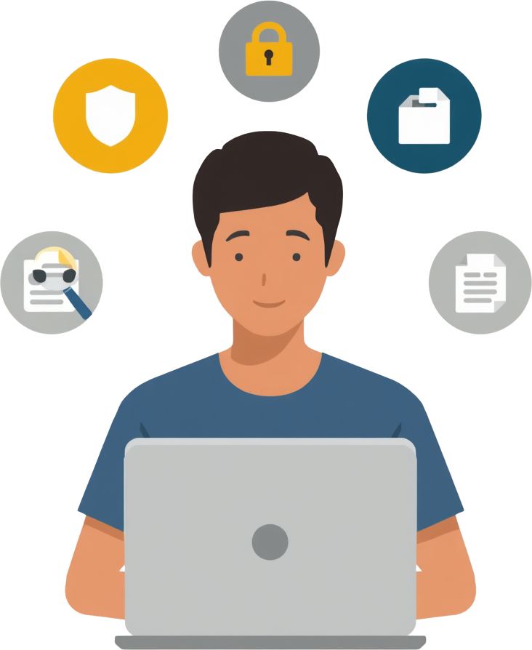
Your Guide to Digital Success
Safe Internet Practices: Create strong, unique passwords for each account. Always verify sources before sharing information. Protect personal details and think before clicking links. Report suspicious activity to trusted adults.
Digital literacy is the ability to find, evaluate, and effectively use digital information. It empowers students to navigate the online world confidently.
Useful Tools for Students: Google Docs for collaborative writing, Notion for organizing notes and projects, Canva for creating visual presentations, and Grammarly for improving writing quality. These tools enhance productivity and creativity in learning.
Digital Literacy Essentials

